Slide 1
Software Engineering
team project #2
Digital Watch – SD
Team 7
김소영 (201511248) 지우영 (201511299)
문승훈 (201714284) 김현재 (201812308)

Slide 2
Index
SA 수정
Structured Charts Transform Analysis
Structured Charts - Basic
Structured Charts - Advanced

Slide 3
SA 수정

Slide 4
DFD Level 2
System Context Diagram
DFD Level 0
DFD Level 1
DFD Level 2
DFD Level 3
DFD Level 4
DFD
Backlight
Control
2.1
Light
Command
Backlight
Interface
2.4
Light
Tick
Alarm Data Storage
Get
Alarm
data
Button Data
Alarm Data
Update
Alarm
data
Main Control
2.2
Display
command
Screen
Interface
2.5
Display
Button Data
Get
State
data
Tick
Update
State
data
Button Data
Alarm Data
State Data Storage
Speaker
Control
2.3
Sound
Command
Speaker
Interface
2.6
Sound
Tick

Slide 5
DFD Level 2 (수정)
System Context Diagram
DFD Level 0
DFD Level 1
DFD Level 2
DFD Level 3
DFD Level 4
DFD
Backlight
Control
2.1
Light
Command
Backlight
Interface
2.4
Light
Tick
Alarm Data Storage
Get
Alarm
data
Button Data
Alarm Data
Update
Alarm
data
Main Control
2.2
Display
command
Screen
Interface
2.5
Display
Button Data
Get
State
data
Tick
Update
State
data
Button Data
Alarm Data
State Data Storage
Speaker
Control
2.3
Sound
Command
Speaker
Interface
2.6
Sound
Alarm Data Storage
Update
Alarm data
Tick

Slide 6
DFD Level 3 Main Controller
Time Keeping Mode
2.2.2
Display Command
Time Keeping Set
2.2.3
Display Command
System Context Diagram
DFD Level 0
DFD Level 1
DFD Level 2
DFD Level 3
DFD Level 4
DFD
Enable
State Data Storage
Disable
Trigger
Time Keeping Unit Change
2.2.4
Display Command
Update
State
data
Get
State
data
Alarm Data Storage
Trigger
Get
Alarm
data
Stop
Watch
Mode
2.2.5
Display Command
Update
Alarm
data
Main
Controller
2.2.1
Tick
Trigger
Stop
Watch
Run
2.2.6
Display Command
Button Data
Trigger
Trigger
Stop
Watch
Laptime
2.2.7
Display Command
Alarm Data
Trigger
Trigger
Button Data
Alarm Mode
2.2.9
Trigger
Display Command
Trigger
Trigger
Stop
Watch
Pause
2.2.8
Display Command
Trigger
Alarm Unit Change
2.2.11
Mode Change
2.2.13
Trigger
Display Command
Display Command
Alarm Set
2.2.10
Display Command
Add Value
2.2.14
Alarm
Indicator
2.2.12
Display Command
Display Command
Notes:
Stopwatch Initialize -> Mode (Initialize) 따로 또 그려야할 듯..
Trigger를 Enable/Disable
Add value나 Unit Chagne -> Data Storage로 이어지도록..

Slide 7
DFD Level 3 Main Controller (수정)
System Context Diagram
DFD Level 0
DFD Level 1
DFD Level 2
DFD Level 3
DFD Level 4
DFD
Time Keeping Mode
2.2.2
Display Command
Enable
Time Keeping Set
2.2.3
Display Command
Update State Data
State Data Storage
Disable
Enable
Time Keeping Unit Change
2.2.4
State Data Storage
Get
State Data
Disable
Display Command
Tick
Update State Data
Trigger
Stop
Watch
Mode
2.2.5
Main
Controller
2.2.1
Enable
Display Command
Disable
Enable
Stop
Watch
Run
2.2.6
Button Data
Disable
Display Command
Alarm Data
Enable
Trigger
Stop
Watch
Laptime
2.2.7
Button Data
Disable
Disable
Display Command
Enable
Alarm Mode
2.2.9
Get
Alarm Data
Trigger
Stop
Watch
Pause
2.2.8
Display Command
Display Command
Alarm Data Storage
Trigger
Alarm Unit Change
2.2.11
Enable
Trigger
Display Command
Disable
Alarm Set
2.2.10
Update Alarm Data
Display Command
Alarm
Indicator
2.2.12
Display Command
Add Value
2.2.14
Display Command
Notes:
Stopwatch Initialize -> Mode (Initialize) 따로 또 그려야할 듯..
Trigger를 Enable/Disable
Add value나 Unit Chagne -> Data Storage로 이어지도록..

Slide 8
DFD Level 3 Speaker Controller
System Context Diagram
DFD Level 0
DFD Level 1
DFD Level 2
DFD Level 3
DFD Level 4
DFD
Alarm
Off
2.3.2
Sound Command
Enable
Speaker
Controller
2.3.1
Disable
Button Data
Alarm Data
Enable
Alarm
Ready
2.3.3
Sound Command
Disable
Enable
Alarm Ringing
2.3.4
Sound Command
Disable
Tick
Tick

Slide 9
DFD Level 3 Speaker Controller (수정)
System Context Diagram
DFD Level 0
DFD Level 1
DFD Level 2
DFD Level 3
DFD Level 4
DFD
Alarm
Off
2.3.2
Sound Command
Enable
Speaker
Controller
2.3.1
Disable
Button Data
Alarm Data
Enable
Alarm
Ready
2.3.3
Sound Command
Disable
Enable
Alarm Ringing
2.3.4
Sound Command
Disable
Tick
Update Alarm Data
Alarm Data Storage
Tick
Notes:
Alarm Ringing 상태에서 버튼 아무거나 입력 들어오면 AS 갱신(Update) -> 가능합니다!!

Slide 10
DFD Level 4 – Main State Transition Diagram
System Context Diagram
DFD Level 0
DFD Level 1
DFD Level 2
DFD Level 3
DFD Level 4
DFD
Tick [Button ‘C’] && !AS &&
mode == timekeep &&
timekeepmode == set &&
/Trigger “Time Keeping Unit Change”
Time Keeping
unit change
Tick [Button ‘A’] && !AS &&
mode == timekeep &&
timekeepmode == set
/Enable “Time Keeping Mode”
/Enable “Time Keeping Mode”
mode == timekeep && !AS &&
timekeepmode == set &&
/Trigger “Time Keeping Set”
Tick [Button ‘B’] && !AS &&
mode == timekeep &&
timekeepmode == set &&
timekeepunit != none
/Trigger “Add Value”
Time Keeping Mode
Time Keeping Set mode
Tick [Button ‘A’] &&
!AS &&
mode == timekeep &&
timekeepmode == default
/Disable “Time Keeping Mode”,
Trigger “Time Keeping Set”
Tick [Button ‘C’] && !AS &&
mode == timekeep &&
timekeepmode == default
/Disable “Time Keeping Mode”
Trigger “Mode Change”
mode == timekeep && !AS &&
timekeepmode == set &&
timekeepunit != none
/Trigger “Time Keeping Set”
Tick
[Button ‘C’] && !AS &&
mode == alarm &&
alarmmode == default
/Enable “Time Keeping Mode”
Tick [Button ‘B’] && !AS &&
mode == stopwatch &&
stopwatchmode == default
/Trigger “Stop Watch Run”
Tick [Button ‘B’] && !AS &&
mode == stopwatch &&
stopwatchmode == run
/Trigger “Stop Watch Pause”
Add Value
Stop Watch Mode
Stop Watch
Run
Stop Watch
Pause
Tick [Button ‘B’] && !AS &&
mode == alarm &&
alarmmode == set &&
alarmkeepunit != none
/Trigger “Add Value”
Tick [Button ‘A’] && !AS &&
mode == stopwatch &&
stopwatchmode == pause
/Trigger “Stop Watch Mode”
Tick [Button ‘B’] && !AS &&
mode == stopwatch &&
stopwatchmode == pause
/Trigger “Stop Watch Run”
Tick [Button ‘C’] && !AS &&
mode == stopwatch &&
stopwatchmode == default
/Trigger “Mode Change”
mode == alarm && !AS &&
alarmmode == set &&
alarmkeepunit != none
/Trigger “Alarm Set”
Tick [Button ‘A’] && !AS &&
mode == stopwatch &&
stopwatchmode == run
/Trigger “Stop Watch Laptime”
Tick [Button ‘B’] && !AS &&
mode == stopwatch &&
stopwatchmode == laptime
/Trigger “Stop Watch Run”
Tick [Button ‘B’] && !AS &&
mode == alarm &&
alarmmode == default
/Trigger “Alarm Indicator”
Stop Watch
Laptime
Tick [Button ‘A’] && !AS &&
mode == alarm &&
alarmmode == default
/Trigger “Alarm Set”
Tick [Button ‘A’] && !AS &&
mode == stopwatch &&
stopwatchmode == laptime
/Trigger “Stop Watch Laptime Renew”
Tick [Button ‘C’] && !AS &&
mode == alarm &&
alarmmode == set &&
/Trigger “Alarm Unit Change”
Alarm
Mode
Alarm
Set Mode
Tick [Button ‘A’] && !AS &&
mode == alarm &&
alarmmode == set
/Trigger “Alarm Mode”
Alarm
Unit Change
Alarm
Indicator
mode == alarm && !AS &&
alarmmode == default
/Trigger “Alarm Mode”
mode == alarm && !AS &&
alarmmode == unitchange
/Trigger “Alarm Set Mode”
Notes:
Tick이 들어왔을 때 아무 데이터도 없는 경우는 X -> Enable을 통해 Time Keeping mode로 돌아가지 않는다.
Time keeping mode process는 timekeepunit을 initialize한다.
Trigger -> Enable Disable (ex. Stopwatch Run – Pause)

Slide 11
DFD Level 4 – Main State Transition Diagram (수정)
System Context Diagram
DFD Level 0
DFD Level 1
DFD Level 2
DFD Level 3
DFD Level 4
DFD
Tick [Button ‘A’] && !AS &&
mode == timekeep &&
timekeepmode == set
/Disable “Time Keeping Set Mode”
Enable “Time Keeping Mode”
Tick [Button ‘C’] && !AS &&
mode == timekeep &&
timekeepmode == set &&
/Disable “Time Keeping Set Mode”
Trigger “Time Keeping Unit Change”
Time Keeping
unit change
Tick [Button ‘B’] && !AS &&
mode == timekeep &&
timekeepmode == set &&
timekeepunit != none
/Disable “Time Keeping Set Mode”
Trigger “Add Value”
/Enable “Time Keeping Mode”
mode == timekeep && !AS &&
timekeepmode == set &&
/Enable “Time Keeping Set Mode”
Time Keeping Mode
Time Keeping Set mode
Tick [Button ‘A’] &&
!AS &&
mode == timekeep &&
timekeepmode == default
/Disable “Time Keeping Mode”,
Enable “Time Keeping Set Mode”
Tick [Button ‘C’] && !AS &&
mode == timekeep &&
timekeepmode == default
/Disable “Time Keeping Mode”
Trigger “Mode Change”
mode == timekeep && !AS &&
timekeepmode == set &&
timekeepunit != none
/Enable “Time Keeping Set Mode”
Tick
[Button ‘C’] && !AS &&
mode == alarm &&
alarmmode == default
/Enable “Time Keeping Mode”
Tick [Button ‘B’] && !AS &&
mode == stopwatch &&
stopwatchmode == default
/Disable “Stop Watch Mode”
Enable “Stop Watch Run”
Tick [Button ‘B’] && !AS &&
mode == stopwatch &&
stopwatchmode == run
/Disable “Stop Watch Run”
Enable “Stop Watch Pause”
Add Value
Stop Watch Mode
Stop Watch
Run
Stop Watch
Pause
Tick [Button ‘B’] && !AS &&
mode == alarm &&
alarmmode == set &&
alarmkeepunit != none
/Trigger “Add Value”
Disable “Alarm Set Mode”
Tick [Button ‘A’] && !AS &&
mode == stopwatch &&
stopwatchmode == pause
/Trigger “Stop Watch Mode”
Tick [Button ‘B’] && !AS &&
mode == stopwatch &&
stopwatchmode == pause
/Disable “Stop Watch Pause”
Enable “Stop Watch Run”
Tick [Button ‘C’] && !AS &&
mode == stopwatch &&
stopwatchmode == default
/ Enable “Stop Watch Mode”
Disable “Time Keeping Mode”
Tick [Button ‘A’] && !AS &&
mode == stopwatch &&
stopwatchmode == run
/Disable “Stop Watch Run”
Trigger “Stop Watch Laptime”
mode == alarm && !AS &&
alarmmode == set &&
alarmkeepunit != none
/Enable “Alarm Set Mode”
Tick [Button ‘B’] && !AS &&
mode == stopwatch &&
stopwatchmode == laptime
/Enable “Stop Watch Run”
Tick [Button ‘B’] && !AS &&
mode == alarm &&
alarmmode == default
/Disable “Alarm Mode”
Trigger “Alarm Indicator ”
Tick [Button ‘A’] && !AS &&
mode == alarm &&
alarmmode == default
/Disable “Alarm Mode”
Enable “Alarm Set Mode”
Stop Watch
Laptime
Tick [Button ‘C’] && !AS &&
mode == alarm &&
alarmmode == set &&
/Disable “Alarm Set Mode”
Trigger “Alarm Unit Change”
Tick [Button ‘A’] && !AS &&
mode == stopwatch &&
stopwatchmode == laptime
/Trigger “Stop Watch Laptime Renew”
Alarm
Mode
Alarm
Set Mode
Tick [Button ‘A’] && !AS &&
mode == alarm && alarmmode == set
/Disable “Alarm Set Mode”
Enable “Alarm Mode”
Alarm
Unit Change
Alarm
Indicator
mode == alarm && !AS &&
alarmmode == unitchange
/Enable “Alarm Set Mode”
mode == alarm && !AS &&
alarmmode == default
/Enable “Alarm Mode”
Notes:
TimeKeeping Mode -> Stop Watch Mode -> Alarm Mode 간 변화 ‘Trigger’ -> ‘Enable / Disable’
Stop Watch Pause <->Run ‘Trigger’ -> “Enable / Disable”
Stop Watch Run <-> Laptime ‘Trigger’

Slide 12
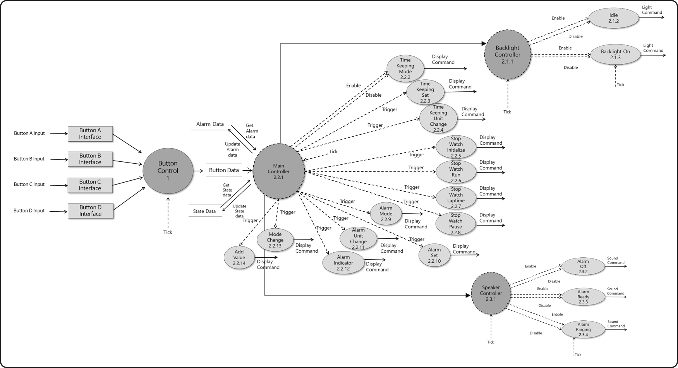
DFD
System Context Diagram
DFD Level 0
DFD Level 1
DFD Level 2
DFD Level 3
DFD Level 4
DFD
Alarm Data
Button Data
Alarm Data
Button Data

Slide 13
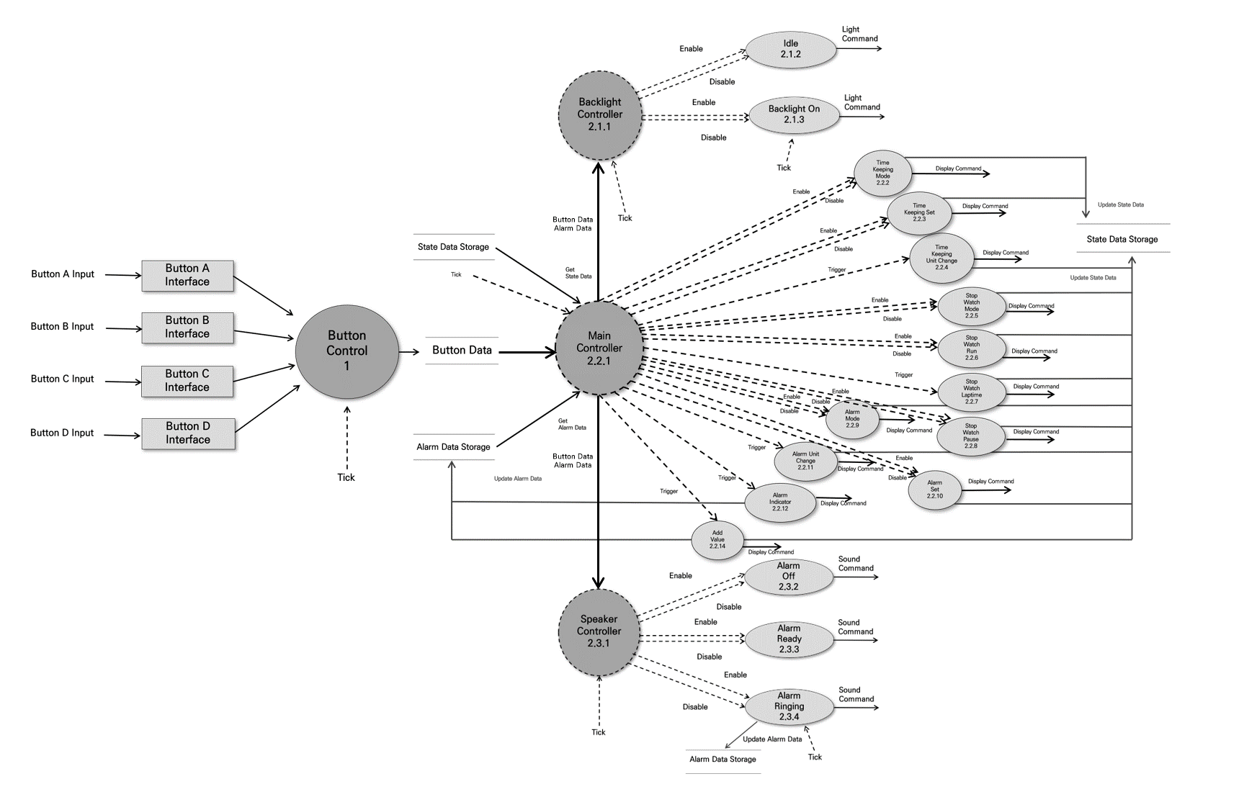
DFD (수정)
System Context Diagram
DFD Level 0
DFD Level 1
DFD Level 2
DFD Level 3
DFD Level 4
DFD

Slide 14
Structured Charts
- Transform Analysis

Slide 15
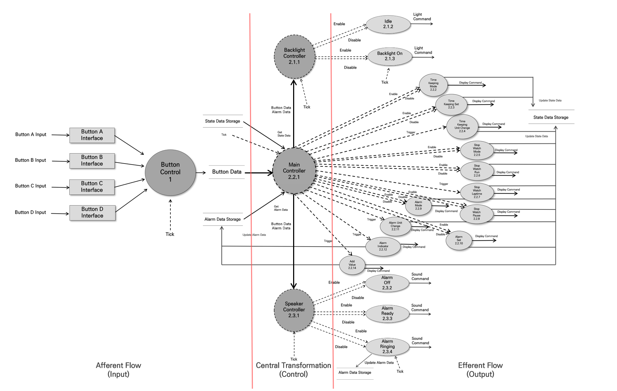
Structured Charts Transform Analysis

Slide 16
Structured Charts
- Basic

Slide 17
Structured Charts – Main
Main
Main Controller
Button Data
State Data
Alarm Data
Enable
Disable
Enable
Disable
Trigger
Button
Control
State Data Storage
Alarm Data Storage
Time Keeping Mode
Time Keeping Set
Time Keeping Unit Change
Enable
Disable
Enable
Disable
Trigger
Trigger
Button A
Interface
Button B
Interface
Button C
Interface
Button D
Interface
Alarm
Mode
Alarm Set Mode
Alarm
Unit Change
Alarm
Indicator
Enable
Disable
Enable
Disable
Enable
Disable
Trigger
Trigger
Stop
Watch
Mode
Stop
Watch
Pause
Stop
Watch
Run
Stop
Watch
Laptime
Add Value
Update
State Data
Update
Alarm Data
State Data Storage
Alarm Data Storage

Slide 18
Structured Charts - Backlight, Speaker
Main
Main Controller
Button Data
State Data
Alarm Data
Button
Data
Alarm
Data
Button
Data
Alarm
Data
Button
Control
State Data Storage
Alarm Data Storage
Backlight Controller
Speaker Controller
Button A
Interface
Button B
Interface
Button C
Interface
Button D
Interface
Enable
Disable
Enable
Disable
Enable
Disable
Enable
Disable
Enable
Disable
Idle
Backlight
On
Alarm
Off
Alarm
Ready
Alarm
Ringing
Update
Alarm
Data
Alarm Data Storage

Slide 19
Structured Charts(Basic)
Main
Main Controller
Button Data
State Data
Alarm Data
Button
Data
Alarm Data
Button
Data
Alarm Data
Button
Control
State Data
Storage
Alarm Data Storage
Enable
Disable
Backlight Controller
Speaker Controller
Enable
Disable
Trigger
Enable
Disable
Time Keeping Mode
Time Keeping Set
Time Keeping Unit Change
Enable
Disable
Enable
Disable
Button A
Interface
Button B
Interface
Button C
Interface
Button D
Interface
Enable
Disable
Enable
Disable
Trigger
Trigger
Idle
Backlight
On
Alarm
Mode
Alarm
Set Mode
Alarm
Unit Change
Alarm Indicator
Enable
Disable
Enable
Disable
Enable
Disable
Enable
Disable
Enable
Disable
Enable
Disable
Trigger
Alarm
Off
Alarm
Ready
Alarm
Ringing
Stop
Watch
Mode
Stop
Watch
Pause
Stop
Watch
Run
Stop
Watch
Laptime
Add Value
Update
Alarm
Data
Update
State Data
State Data Storage
Alarm Data Storage

Slide 20
Structured Charts
- Advanced

Slide 21
Structured Charts – Main
Main
Main Controller
Enable
Disable
Enable
Disable
Trigger
Button Data
State Data
Alarm Data
Time Keeping Mode
Time Keeping Set
Time Keeping Unit Change
Button
Control
State Data Storage
Alarm Data Storage
Trigger
Enable
Disable
Trigger
Enable
Disable
Button A
Interface
Button B
Interface
Button C
Interface
Button D
Interface
Alarm
Indicator
Alarm
Mode
Alarm
Unit Change
Alarm
Set Mode
Trigger
Enable
Disable
Enable
Disable
Enable
Disable
Trigger
Add Value
Stop
Watch
Mode
Stop
Watch
Pause
Stop
Watch
Run
Stop
Watch
Laptime
Update
State Data
Update
Alarm Data
Alarm Data Storage
State Data Storage

Slide 22
Structured Charts - Backlight, Speaker
Main
Main Controller
Alarm Data
Alarm Data
Button Data
State Data
Alarm Data
Button Data
Button Data
Button
Control
State Data Storage
Alarm Data Storage
Backlight Controller
Speaker Controller
Enable
Disable
Enable
Disable
Enable
Disable
Enable
Disable
Button A
Interface
Button B
Interface
Button C
Interface
Button D
Interface
Enable
Disable
Idle
Backlight
On
Alarm
Off
Alarm
Ready
Alarm
Ringing
Update
Alarm Data
Alarm Data Storage

Slide 23
Structured Charts (Advanced)
Main
Main Controller
Alarm Data
Alarm Data
Button Data
Button Data
State Data
Alarm Data
Enable
Disable
Enable
Disable
Trigger
Button Data
Button
Control
State Data Storage
Alarm Data Storage
Time Keeping Mode
Time Keeping Set
Time Keeping Unit Change
Backlight Controller
Enable
Disable
Enable
Disable
Trigger
Trigger
Enable
Disable
Enable
Disable
Button A
Interface
Button B
Interface
Button C
Interface
Button D
Interface
Speaker Controller
Alarm
Mode
Alarm
Set Mode
Alarm
Unit Change
Alarm
Indicator
Idle
Backlight
On
Enable
Disable
Enable
Disable
Enable
Disable
Enable
Disable
Enable
Disable
Enable
Disable
Trigger
Trigger
Alarm
Off
Alarm
Ready
Alarm
Ringing
Stop
Watch
Mode
Stop
Watch
Pause
Stop
Watch
Run
Stop
Watch
Laptime
Add Value
Update
State Data
Update
Alarm Data
State Data Storage
Alarm Data Storage

